Slide 1
the passage from data to knowledge
OR
how is data made meaningful for business users?
it is a complex social process!

Slide 2
information as corporate asset
It has a time value: the value of the information is bound up in its timeliness
Information as a sharable resource
increasing value through increased use
Increasing value through quality: accuracy
Increases in value through merging
==> drives the need to leverage data assets to make sound decisions quickly and lead the organisation to business and operational success
BUT
…as in other organisations “legacy solutions were designed for central control of data so presents an onerous process to scale and answer inquiries across large numbers of requests”. Using Excel for analysis and reporting creates piecemeal, fragmented and siloed data and knowledge…
Loshin, D. (2003). Business Intelligence: The Savvy Manager’s Guide (Savvy Manager's Guides). Morgan Kaufmann.
Anatomy of A Decision –Blue Hill Research Report for Tibco

Slide 3
research site
A University has had a BI project that for the last year has been using Tableau server to develop better management reporting the Planning team
University has now has a server license capable of supporting the whole Uni, 250+ users, and about 230+ different dashboards used across most department and at various reporting levels within the university.
They also have 50+ desktop licenses where people across the organisation are actually building their own dashboards and publishing them to the server

Slide 4
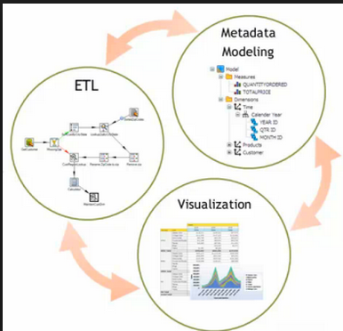

the research
Looking at how the dashboards that are on this server are being developed and are used
“Embedded” in the planning unit since May, making some observations, interviewing some key users about their use of the dashboards, and building a dashboard or two
There is a lot going on… but what was clear was that the visualisation and the structuring of the data to drive the visualisation are interlinked, and it is a collaborative social process
So the unit of analysis is the social unit : community of practice

Slide 5
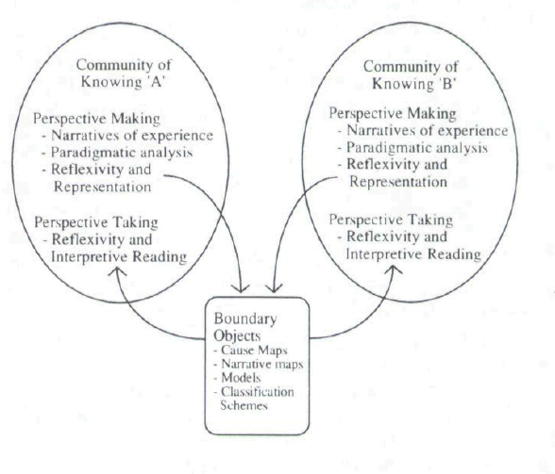
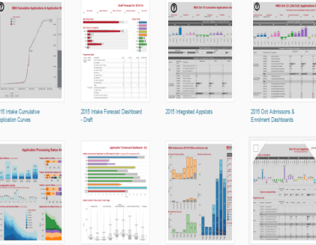
using a model describes an ecology of communities of knowing in distributed environments
Within the community there is a process of complexification-emphasis on the analytical, deductive, linearity and certainty
…and then out of the need to cooperate and collaborate representation of what is known and the reflection produce boundary objects
With the division of labour comes the development of areas of specialisation: expertise, ways of working, language and tools which are incommensurable
… this allows second order knowledge work to take place allowing other communities to take into account another’s way of knowing>> Innovation
The model suggests a BI development strategy for the University
Boland, R. J. R., & Tenkasi, R. V. (1995). Perspective making and perspective taking in communities of knowing. Organization Science, 6(4), 350–372.

Slide 6
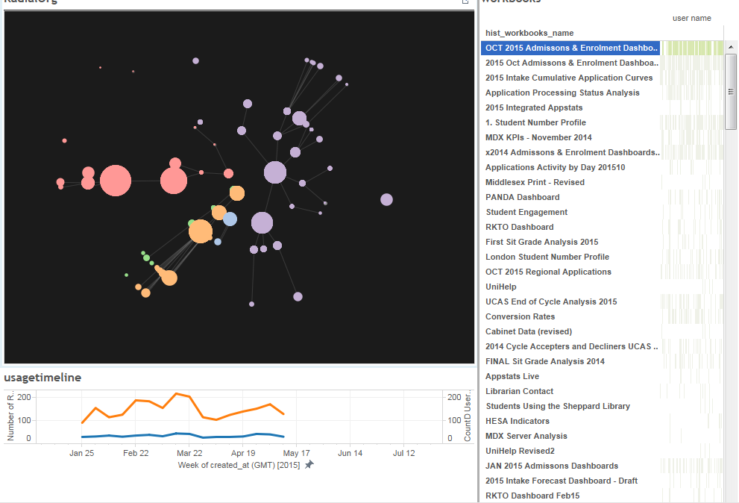
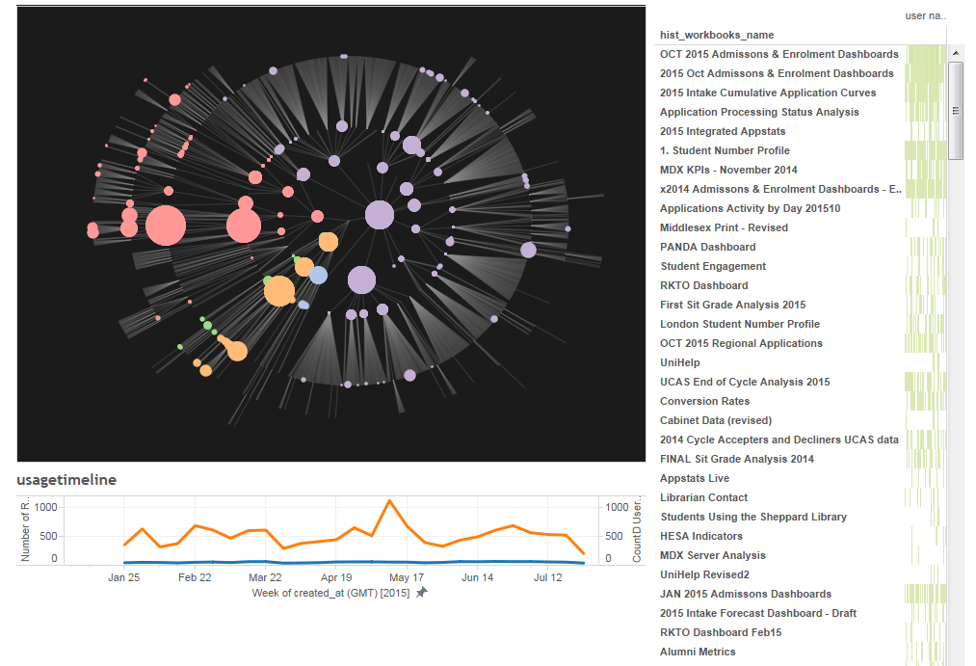
besides qualitative research I am also looking at how dashboards are being used across the University

Slide 7
different dashboards have different profiles of use

Slide 8
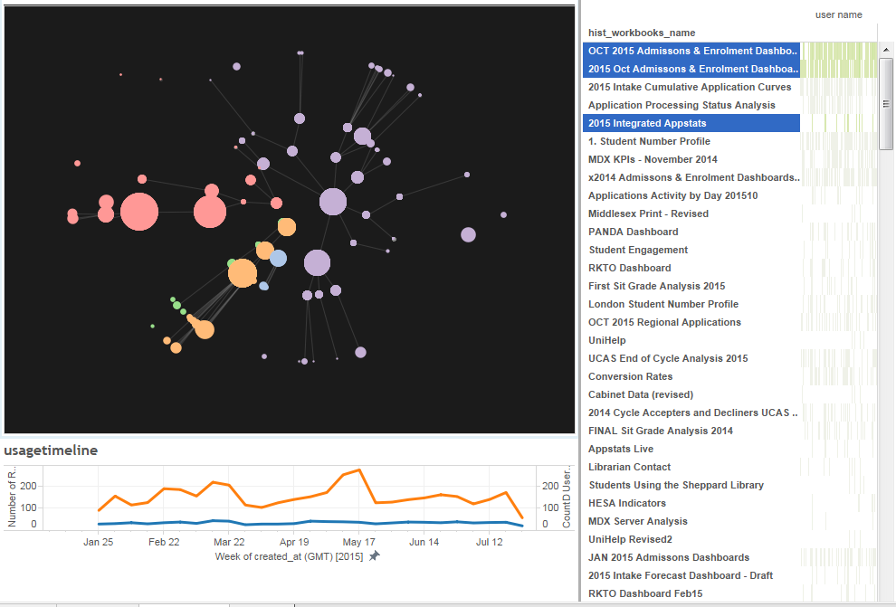
Reflects the diffusion of knowledge

Slide 9
infrastructure: developing a common information space
Tableau is fast becoming the de facto reporting tool and some dashboards are being used across many functions this raises some further challenges:
  Standardisation: a house style, common dictionary, official interpretation
  Usability issues become much more demanding
  An overarching way of organising not only the dashboards but the whole process of developing them and publishing them, making sure that each part is supported
  Performance metrics for the whole initiative
  Data governance
  ➔ Entails extra work on top of building the dashboards and can be seen as a mutually recognised need for organisational control

Slide 10
Challenges
To understand the role that the dashboards (as rich epistemic artifacts) have in knowledge generation and transference within the organisation and inter-organisationally
To represent the knowledge ecosystem in a way that informs its design and manages it

